Slide 1
Hypothesis testing
MODULE 3
BHAVYA H
STATISTICS PROFESSIONAL
SPOCTEC TECHNOLOGICAL AND RESEARCH CENTRE

Slide 2
Basic terminologies
Population : All of the entities of interest in a study.
Sample: A subset of the population.
Alternative Hypothesis: Hypothesis that the analyst is attempting to prove, denoted by H_{a}
Null Hypothesis: The opposite of the alternative hypothesis, denoted by H₀
Notes:
Hypothesis testing is one of the two common forms of statistical inference. This slide reviews some of the terms that form the basis of statistical inference, as introduced in the prior chapter. Make certain you understand these basics before proceeding.

Slide 3
ONE AND TWO TAILED TESTS
The equality part of the hypotheses always appears in the null hypothesis.
In general, a hypothesis test about the value of a population mean μ must take one of the following three forms (where μ₀ is the hypothesized value of the population mean).
One-tailed
(left-tail)
One-tailed
(right-tail)
Two-tailed

Slide 4
TYPE I AND TYPE II ERRORS
A Type I error is rejecting H₀ when it is true.
The probability of making a Type I error is called the level of significance.
A Type II error is accepting H₀ when it is false.
The probability of accepting a true alternative hypothesis is called the power of the test.

Slide 5
Type I and Type II Errors
True State
H₀ True
H₀ False
Decision from sample
Accept H₀
Correct
Decision
Type II Error
Reject H₀
Type I Error
Correct
Decision

Slide 6
A test statistic, is a function of the sample data on which the decision is to be based.
The p-value is the probability that the value of test statistic is at least as extreme as its computed value on the basis of the sample data under .
The value of test statistic which separates the critical region and the acceptance region is called the critical value or significant value.

Slide 7
Steps of Hypothesis Testing
Step 1. Develop the null and alternative hypotheses.
Step 2. Specify the level of significance .
Step 3. Collect the sample data and compute the test statistic.
p-Value Approach
Step 4. Use the value of the test statistic to compute the
p-value.
Step 5. Reject H₀ if p-value < .

Slide 8
Steps of Hypothesis Testing
Critical Value Approach
Step 4. Use the level of significance to determine the critical value.
Step 5. If the computed value of the test statistic lies in the rejection region, reject H₀ at level of significance .

Slide 9
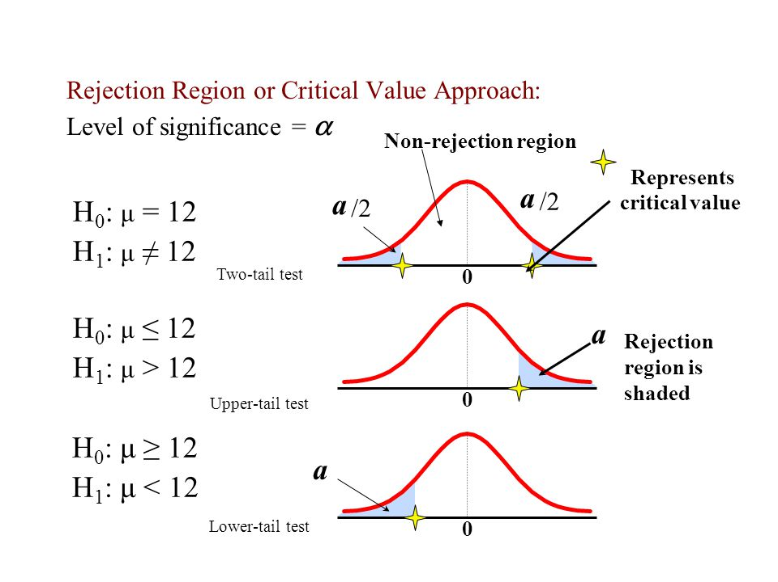

Slide 10
t-Test and F-Test

Slide 11
BASIC FUNDAMENTAL ASSUMPTIONS
The parent population(s) from which the sample(s) is(are) drawn is normal.
The sample(s) is(are) random and independent of each other.

Slide 12
t-TEST
APPLICATIONS
To test if the sample mean ( ) differs significantly from the hypothetical value μ of the population mean.
To test the significance of the difference between two sample means.
To test the significance of an observed sample correlation coefficient and sample regression coefficients.

Slide 13
EXAMPLE
Certain pesticide is packed into bags by a machine. A random sample of 10 bags is drawn and their contents are found to weigh (in kg.) as follows:
50, 49, 52, 44, 45, 48, 46, 45, 49, 45
Test if the average packing can be taken to be 50 kg.
Null Hypothesis, H₀ :
Alternative Hypothesis, H_{a} :

Slide 14
EXAMPLE CONTINUED
Degrees of Freedom
Under H₀ the test statistic is:
which follows t-distribution with 9 d.f.

Slide 15
EXAMPLE CONTINUED
Tabulated for 9 d.f. is 2.262. Since calculated is greater than tabulated t, we reject the null hypothesis at 5% level of significance.
Thus the average packing cannot be taken to be 50kgs.

Slide 16
t-Tests
Test | Test Statistic | Degrees of Freedom
Two sample t-test for difference of means (independent samples) | Where
Paired t-test | where
t-test for sample correlation coefficient
t-test for regression coefficient

Slide 17
t-Test for Difference of Means
( Independent Samples)
Assumption: Population variances are equal.
EXAMPLE
A group of 5 patients treated with medicine ‘A’ weigh
42, 39, 48, 60, and 41 kgs.
Second group of 7 patients from the same hospital treated with medicine ‘B’ weigh
38, 42, 56, 64, 68, 69 and 62 kgs.
Do you agree with the claim that medicine ‘B’ increases the weight significantly?

Slide 18
EXAMPLE CONTINUED
i.e., there is no significant difference between the medicines A and B as regards their effect on increase in weight.
i.e., medicine B increases the weight significantly.

Slide 19
EXAMPLE CONTINUED
Degrees of Freedom
Tabulated value of t for 10 d.f. at 5% level of significance for the single tailed test is 1.81.
Since calculated is less than tabulated t, do not reject the null hypothesis.
Conclusion: The medicines A and B do not differ significantly as regards their effect on increase in weight.

Slide 20
t-Test for Difference of Means
( Independent Samples)
When population variances are unequal, the t-test statistic for difference of means is:
Degrees of freedom:

Slide 21
PAIRED t-TEST
For paired t-test:
The sample sizes are equal, i.e., .
The sample observations are not completely independent but they are dependent in pairs.
EXAMPLE
An IQ test was administered to 5 persons before and after they were trained. The results are given below:
Candidates: I II III IV V
IQ before training: 110 120 123 132 125
IQ after training: 120 118 125 136 121
Test whether there is any change in IQ after the training programme.

Slide 22
EXAMPLE CONTINUED
In this problem, the IQ readings before training(X) and after training(Y) are not independent but are paired together.
Null Hypothesis i.e., mean scores before training and after training are same. In other words, there is no significant change in IQ after the training programme.
Alternative Hypothesis . (Two tailed)
Under null hypothesis, the test statistic is:
Degrees of Freedom

Slide 23
EXAMPLE CONTINUED

Slide 24
EXAMPLE CONTINUED
The tabulated value of t for 4 d.f. and at 1% level of significance for a two tailed test is 4.60. Since calculated is less than tabulated t, the data do not provide any evidence against the null hypothesis which may be accepted. We may, therefore, conclude that there is no change in IQ after the training programme.

Slide 25
F-TEST
APPLICATIONS
To test the equality of two population variances.
To test the linearity of regression.
For testing equality of several means. This test is carried out by the technique of analysis of variance.

Slide 26
F-TEST FOR EQUALITY OF TWO POPULATION VARIANCES
The test statistic for testing equality of variances is
Where:
The test statistics follows F-distribution with degrees of freedom:

Slide 27
EXAMPLE
It is known that the mean diameter of rivets produced by two firms A and B are practically the same but the standard deviations may differ. For 22 rivets produced by firm A, the standard deviation is 2.9 mm. while for 16 rivets manufactured by firm B, the standard deviation is 3.8 mm. Test whether the products of firm A have the same variability as those of firm B.
We are given,
, ; ,
Null Hypothesis i.e., the products of both the firms A and B have the same variability.
Alternative Hypothesis
;

Slide 28
EXAMPLE CONTINUED
Since , the test statistic under null hypothesis is:
which follows F-distribution with (15,2) d.f.
Tabulated
Since calculated F is less than tabulated F, the hypothesis of equal variability may be accepted at 5% level of significance.

Slide 29
F-TEST FOR EQUALITY OF SEVERAL MEANS

Slide 30
ANOVA TABLE
F-statistic
Source of variation
d.f.
Mean Sum of Squares
Sum of squares
SSB
(sum of squared deviations of group means from grand mean)
Treatments
(Between classes)
k-1
Error
(Within classes)
n-k
SSW
(sum of squared deviations of observations from their group mean)
(sum of squared deviations of observations from grand mean)
Total variation
TSS=SSB + SSW
n-1

Slide 31
EXAMPLE
A manufacturing company has purchased three new machines of different makes and wishes to determine whether one of them is faster than the others in producing a certain output. Five, hourly production figures are observed at random from each machine and the results are given below.
Test whether the machines are significantly different in their mean speeds.

Slide 32
EXAMPLE CONTINUED
Here, the factor of variation is machines ( ).
We set up the hypotheses:
Null Hypothesis : i.e., all machines are equally effective.
Alternative Hypothesis : At least two of the means are not equal.
We have, ; ;

Slide 33
EXAMPLE CONTINUED
ANOVA TABLE
The critical value of F for (2,12) d.f. and 5% level of significance is 3.89. Since the computed value of test statistic is greater than the critical value, we reject the null hypothesis at 5% level of significance. Thus, we conclude with 95% confidence that the machines
differ significantly.

Slide 34
CHI-SQUARE TEST
Applications :
To test if the population has a specified value of the variance .
To test the goodness of fit.
To test the independence of attributes.

Slide 35
CHI-SQUARE TEST
Test | Test Statistic | Degrees of Freedom
Test for population variance | Where
Test for goodness of fit
Test for independence of attributes 2 X 2 contingency table

Slide 36
CHI-SQUARE TEST FOR GOODNESS OF FIT
EXAMPLE
The theory predicts the proportion of beans, in the four groups A, B, C and D should be 9 : 3 : 3 : 1 . In an experiment among 1600 beans, the numbers in the four groups were 882, 313, 287 and 118. Does the experimental result support the theory?
Null Hypothesis: There is no significant difference between the experimental values and theory.
Alternative Hypothesis: There is a significant difference between the observed and theoretical values.

Slide 37
Under the theory, the proportion of beans in four groups A, B, C and D should be 9 : 3 : 3 : 1. Hence their expected frequencies for various categories are:
Category | Expected Frequency (E)
A
B
C
D

Slide 38
Degrees of Freedom
Tabulated for 3 d.f. is 7.81
Since calculated value of chi-square is less than the tabulated value, the null hypothesis may be accepted at 5% level of significance.
Conclusion: Experimental results support the theory.

Slide 39
CHI-SQUARE TEST FOR INDEPENDENCE OF ATTRIBUTES
EXAMPLE
In a certain sample of 2000 families 1400 families are consumers of tea. Out of 1800 Hindu families, 1236 families consume tea. Test whether there is any significant difference between consumption of tea among Hindu and non-Hindu families.
The above information can be arranged in a 2×2 contingency table as given below:
Null Hypothesis: The two attributes viz., ‘consumption of tea’ and the ‘community’ are independent. In other words, there is no significant difference between the consumption of tea among Hindu and non-Hindu families.

Slide 40
Alternative Hypothesis: There is a significant difference between the consumption of tea among Hindu and non-Hindu families.
The test statistic is
Tabulated for 1 d.f. is 3.841.
Since the calculated value of is much greater than the tabulated value of at 5% level of significance, reject the null hypothesis and conclude with 95% confidence that the two communities (Hindus and non-Hindus) differ significantly as regards the consumption of tea among them.

